Slide 1

Debugging in C#

Slide 2
What is Debug?
Debugging is the process of finding errors during application execution. It does not mean syntax errors, with which the application cannot be compiled, but on logic errors.
Logic errors can only be noticed during application execution.
Debugging helps to determine the origin of the logical error in the code. In such situations, Debug allows us to stop execution on a particular line, pass through the code line by line, and test the state of the application.

Slide 3
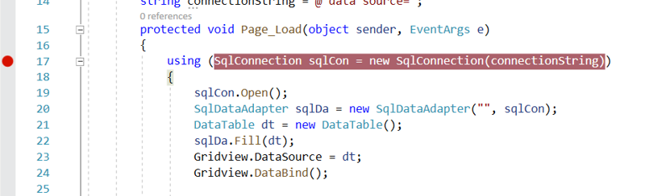
Debug Background code
The basic tool for achieving Debug application code in the Visual Studio development environment is break points.
Break points are set by clicking on the margin on the left side of the code in the appropriate line.

Slide 4
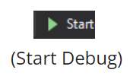
To stop Debug, it is sufficient to select the Start option, or the Start Debugging option from the Debug menu, or simply the F5 key.
After running, Debug execution will be stopped in the line where the breakpoint is defined.
Further management of execution can be done by using the Step Into, Step Over and Step Out keys.

